Slide 1
Customer Review Analysis
British Airways

Slide 2
Topics:
Data Acquisition
Data Cleaning
Data Validity
Sentiment Analysis
Key Issues Encountered

Slide 3
Data Acquisition:
Data was colleceted via web scrapoig from a reputed flight experince sharing platform.
Reviews were from verified as well as unverified sources.
Data Cleaning:
Scraped data was cleaned to remove irrelevant text fields
Data was normalized by diviiding into different fields​

Slide 4
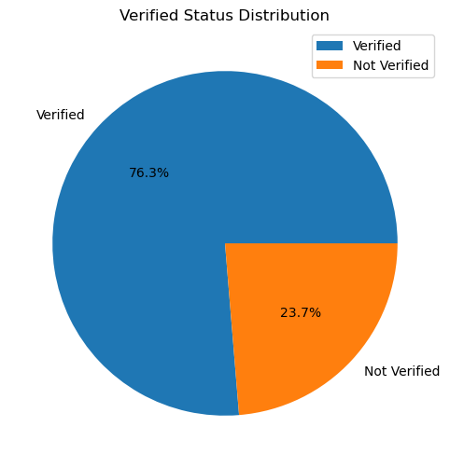

Slide 5
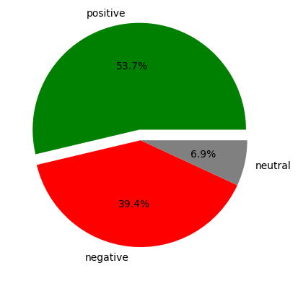
Sentiment Anaysis
Review sentiments were catagorized to:
a. Positive
b. Negative
c. Neutral
2. The pie chart shows the destribution of diffent sentiments as seen from the review data

Slide 6
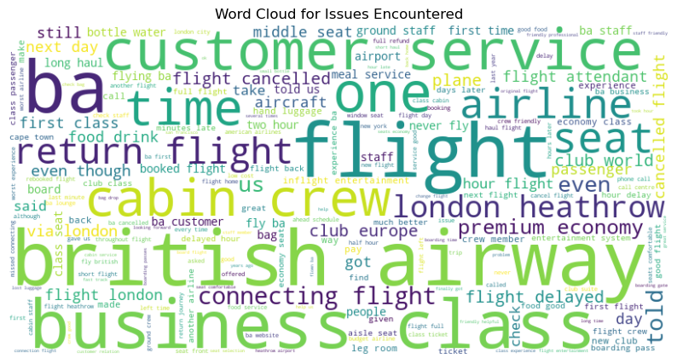
Key Issues Encountered by Passengers:

Slide 7
Key issues to focus on:
Cabin Crew
Buisness Class
Connecting Flight
Flight Delay
Customer Service
Airline Seats
Flight Attendent

Slide 8
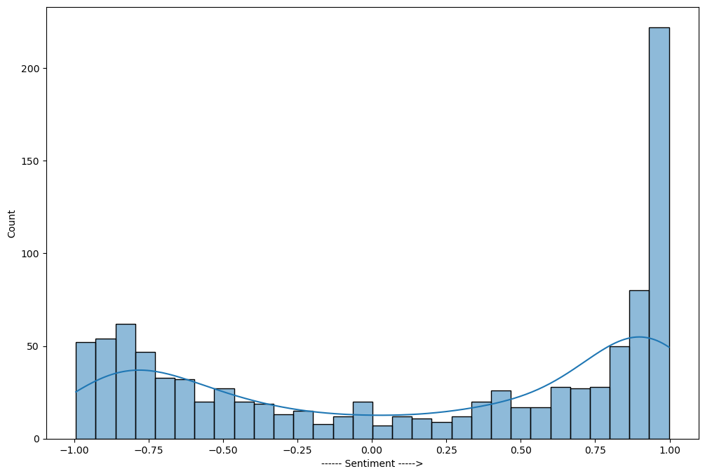
Sentiement Score Destribution:

Slide 9
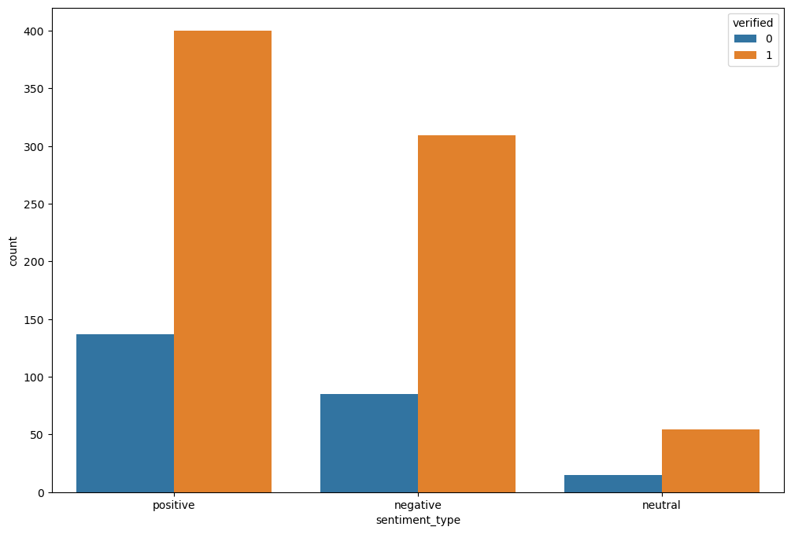
Sentiment Destribution by Verified Status:
Null Hypothesis: Failed To Reject
Therefore, verified and unverified class do not have any difference.

